Slide 1

Set Up Timeline

Slide 2

SET UP GOALS
Goal for Call…
Discuss steps of implementation
Create a timeline of action items & deliverables
Plan training events

Slide 3
SET UP STEPS
Areas of focus…
Employees – users of the product
Criteria – what gets measured
Reviews – how measurements are realized

Slide 4
SET UP FOCUS
What to consider with Employee’s…
Who will be using Threads?
When would you like them to begin?
What are their permission levels?

Slide 5



USER LEVELS
3 User Levels…
Admin – see all information
Manager – see employees beneath them in org chart
Employee – See their information only

Slide 6
EMPLOYEE UPLOAD
Used to…
Populates Org Chart
Create Employee Profiles
Establish Departments & Job Titles

Slide 7
HOW WE MEASURE
Threads uses the criteria listed in your core values & job descriptions, to measure employee performance and cultural alignment.
Core Values + Job Description = Results

Slide 8
HOW WE MEASURE
Core Values – this criteria describes the desired behaviors and characteristics of the all employees
All employees have the same core value criteria
Job Description – this criteria describes the areas of focus and expectations for a specific position
Each position will have its own criteria

Slide 9


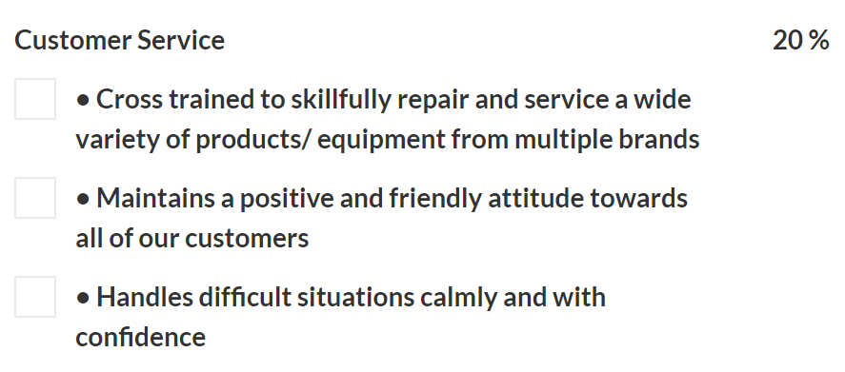

CRITERIA BREAKDOWN
Heading area of focus
Weighting % of result
Components clarity of focus

Slide 10
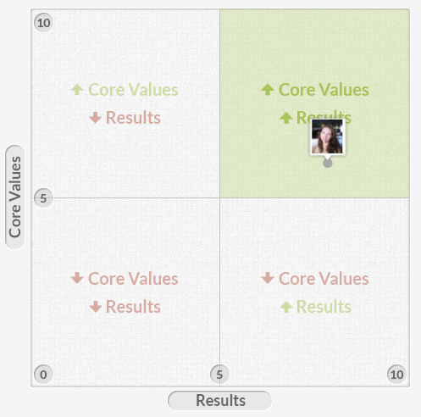
HOW WE MEASURE
How an employee is scored on Core Values and Job Description criteria determines placement on graph.
CORE VALUES
JOB DESCRIPTION

Slide 11
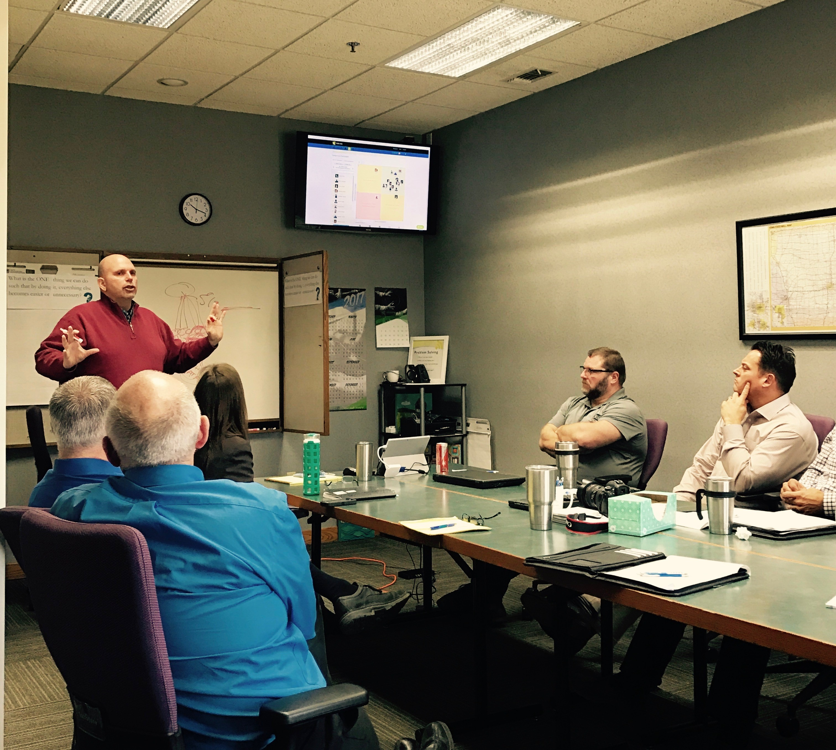
THREADS TRAINING
Provided with subscription…
Admin Training
  online only
Manager Training
  online or onsite
Employee Training
  online or onsite

Slide 12
SET UP TIMELINE
Implementation Date
Roll out to all employees
Employee Upload
Complete and return employee upload spreadsheet
Core Values
Send current values, revise or create
Job Descriptions
Utilize THREADS knowledge base or convert
Training
Pick dates & times

